Slide 1




INTERNET AND WEB BASICS
  PROGRAMMING FOUNDATIONS WITH JAVASCRIPT, HTML AND CSS (COURSERA)
  WEB DEVELOPMENT (SOLOLEARN)
Khayatkhan Satymbekova
My certificate:
  https://coursera.org/share/9fe8efd392131b022b2282ac160aa898
  https://www.sololearn.com/certificates/CC-TXQBIBO6

Slide 2
  PROGRAMMING FOUNDATIONS WITH JAVASCRIPT, HTML AND CSS (COURSERA)
My certificate:
  https://coursera.org/share/9fe8efd392131b022b2282ac160aa898

Slide 3





ABOUT MY
COURSE 1
Programming Foundations with JavaScript, HTML and CSS offered by Duke University.
This course introduces the fundamental building blocks of web development. Throughout the program, I learned how to create structured webpages using HTML, design layouts and apply styles with CSS, and write interactive logic using JavaScript.
The course combines theory with hands-on practice and includes multiple exercises, coding challenges, and a final mini-project.

Slide 4

WHY I SELECTED THIS
CERTIFICATION
1
  It aligns with my interest in web development.
  It develops practical coding skills.
The program focuses not only on theory but also on writing real code.
• It provides 30+ hours of structured study.
The course fits the academic requirement for duration and offers well-organized learning materials, quizzes, and projects that ensure consistent progress.
• It includes HTML, CSS, and JavaScript.
These three technologies form the foundation of web development.
2
  It teaches both theory and hands-on programming.
3
  I gained a balance of conceptual understanding and practical experience.

Slide 5

COURSE DURATION
The total study time for this certification was approximately 30–35 hours.
The duration fully fits the current semester requirement for course length.
The program includes 4 complete modules, along with quizzes, coding exercises, and a final project, ensuring a deep understanding of each topic.
COURSE STRUCTURE
This certification consists of 4 main modules, each focusing on a key aspect of web programming:
HTML & CSS Basics — building webpage structure and styling.
Computational Thinking + JavaScript — learning programming logic and image processing.
Event-Driven Web Programming — creating interactive webpages using user actions and events
Final Mini Web Project — building an image-filtering website using HTML, CSS, and JavaScript.

Slide 6

MODULE 1
MODULE 1 SKILLS
By completing this module, I learned how to:
  Create a fully structured HTML webpage
  Add headings, paragraphs, and ordered/unordered lists
  Insert images using attributes such as alt, height, and width
  Apply CSS selectors to style different elements
  Format text using bold, italic, and other HTML tags
  Use header tags from h1 to h6 to organize content hierarchy
HTML & CSS — Build Your First Web Page
This module introduces the foundational concepts of web development.
Its main goals include:
  Understanding the basic structure and purpose of HTML
  Learning how to apply styles using CSS
  Adding essential elements such as text, images, lists, and tables
  Exploring HTML metadata and sectioning elements to properly organize a webpage

Slide 7
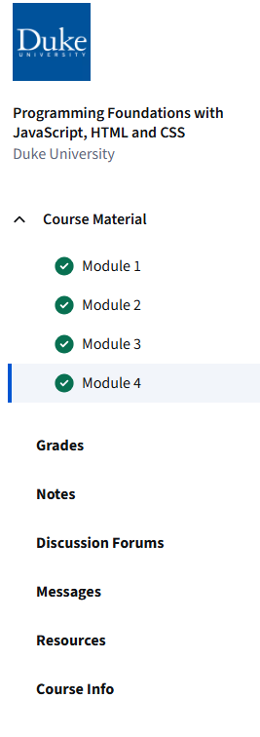
Module 2: Computational Thinking + JavaScript Basics
In this module, I learned how programming logic works and how to think like a programmer.
The module focuses on understanding the fundamental concepts behind code execution, problem-solving, and algorithm creation.
By completing Module 2, I learned
  How functions work — how to define functions, call them, and reuse code efficiently
  Return vs print — understanding the difference between returning a value and displaying it
  For loops — how to repeat actions and loop through data
  If statements — how to make decisions in code
  Nested conditions — writing if statements inside another if statement for more complex logic
  Image pixel processing using the SimpleImage library — looping through every pixel, detecting colors, and modifying images

Slide 8
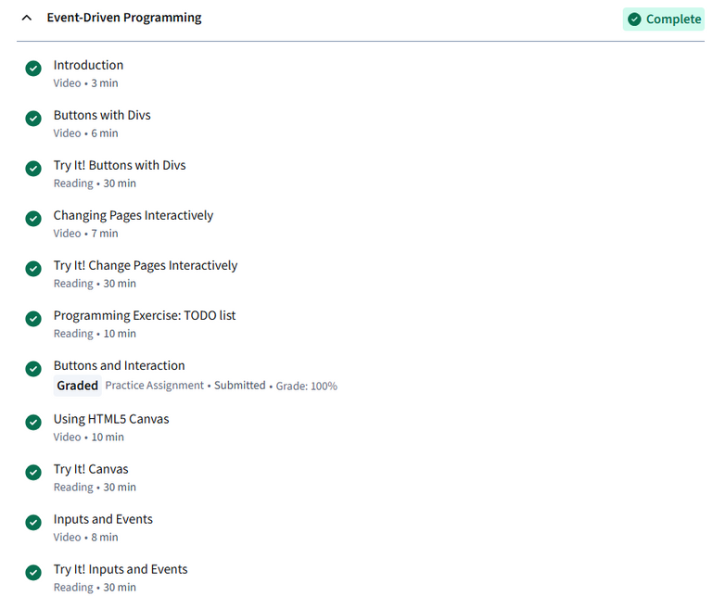
Module 3: Event-Driven Web Programming
This module focuses on making webpages interactive.
I learned how webpages can respond to user actions such as clicking buttons, moving sliders, typing text, or interacting with different elements.
During this module, I learned how to:
  Create interactive buttons that respond when clicked
  Build sliders and display the real-time slider value on the page
  Change canvas size dynamically based on user input
  Capture and display text or numbers entered by the user
  Modify the content of divs dynamically, allowing the webpage to update without refreshing

Slide 9
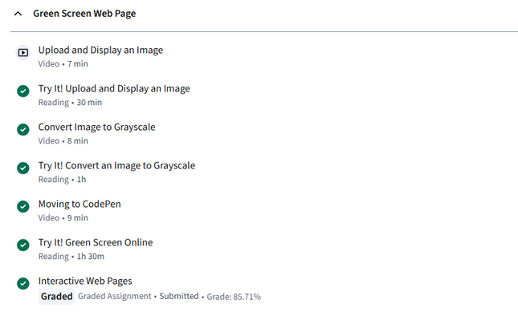
1
Module 4: Final Web Project
In this final module, I applied everything I learned from HTML, CSS, and JavaScript to build a complete mini-website.
The main goal of the project was to create a webpage where users can:
  Upload an image
  Apply different filters (blur, grayscale, color effects, etc.)
  Interact with buttons and sliders
  See changes in real time
In this project, I used the full set of web development skills:
  HTML structure to build the layout and upload area
  CSS design to style the interface and create a clean layout
  JavaScript functions to control image processing and interactivity
  Image filtering tools to apply different visual effects
  Buttons, sliders, and canvas to let users interact with the image in real time
2
3

Slide 10
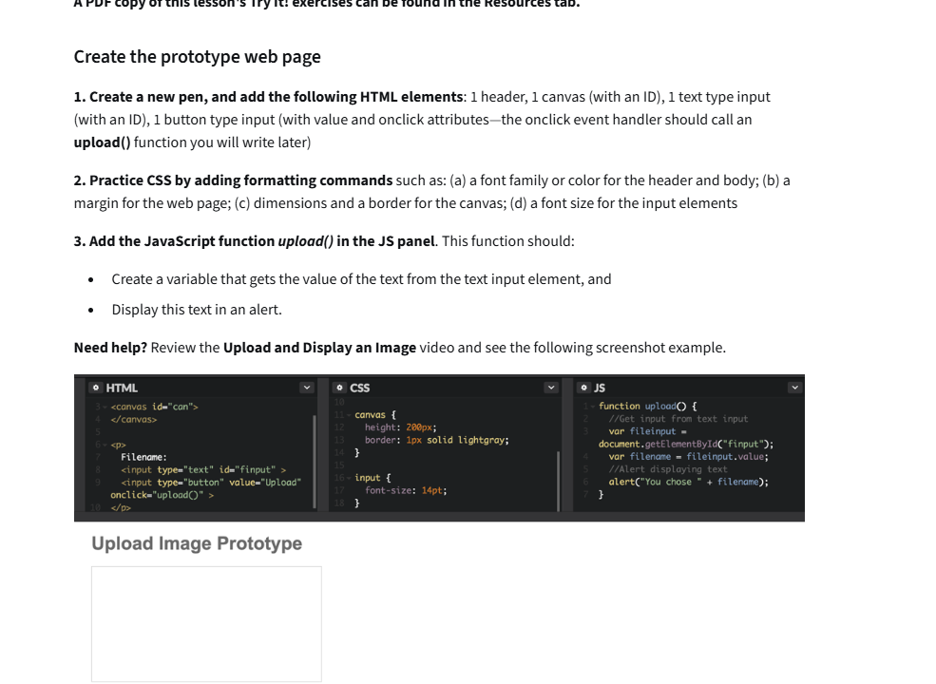

Slide 11
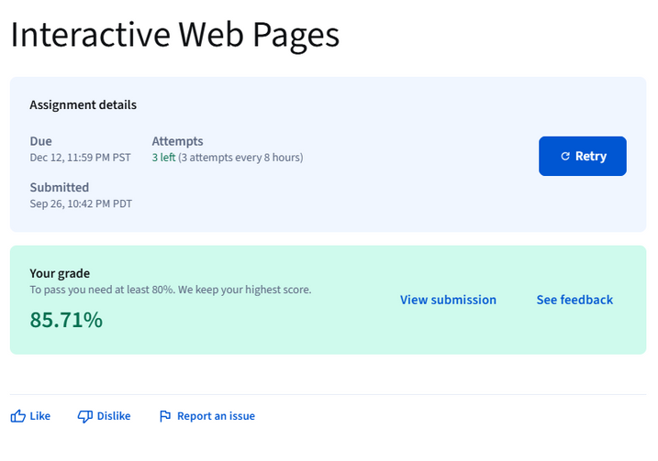
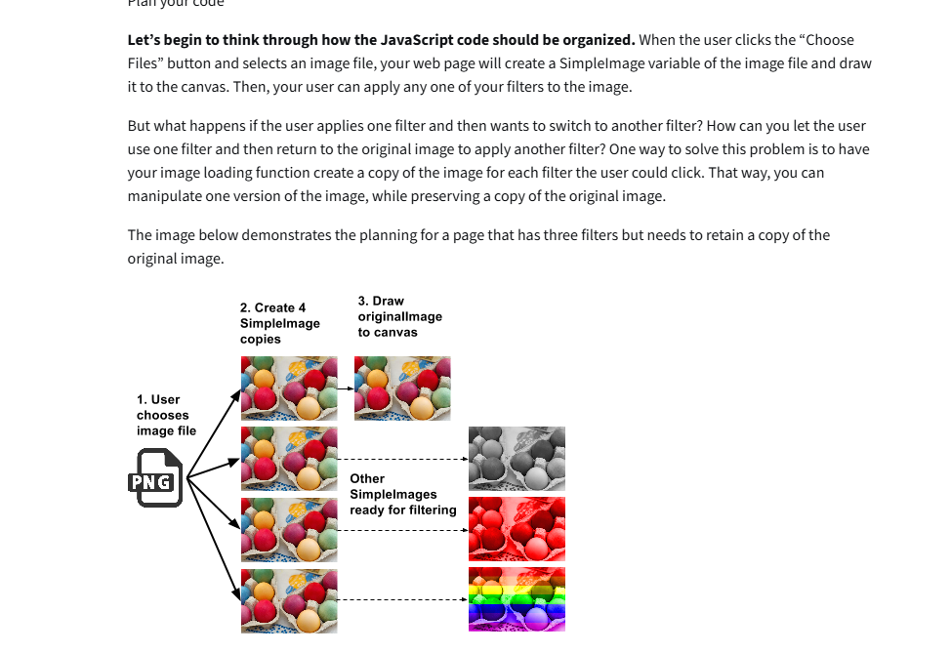
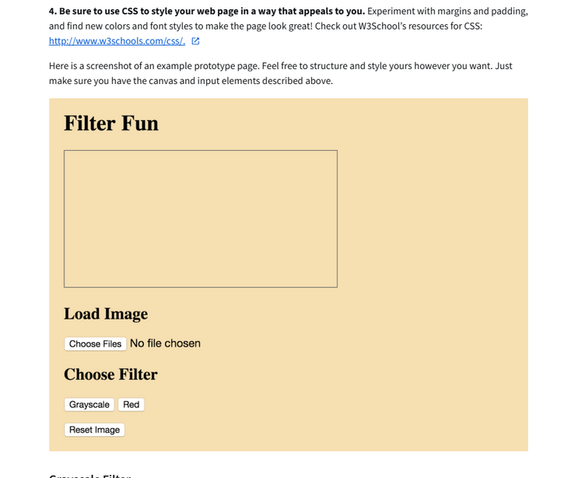

Slide 12
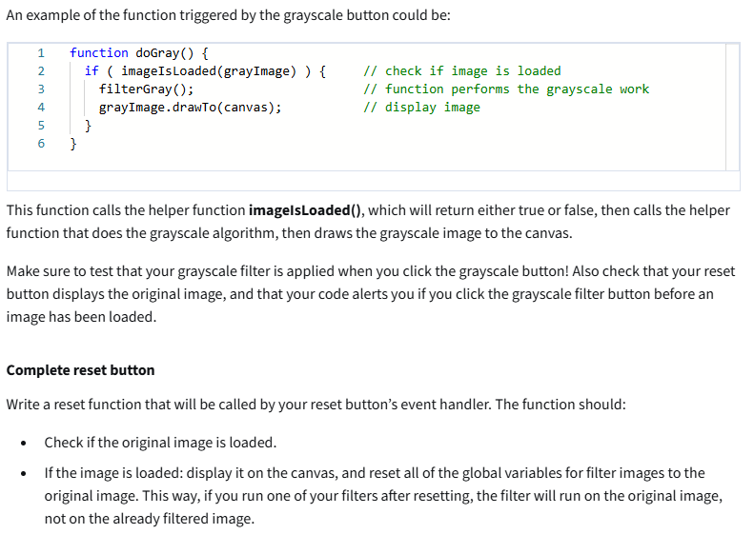

Slide 13
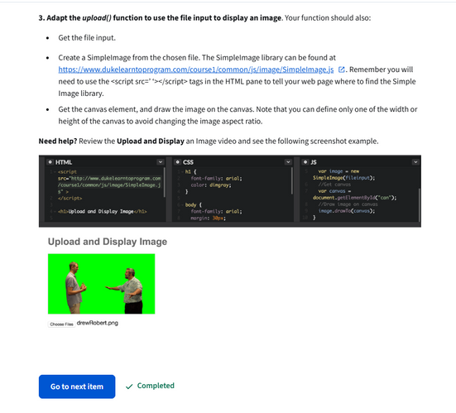
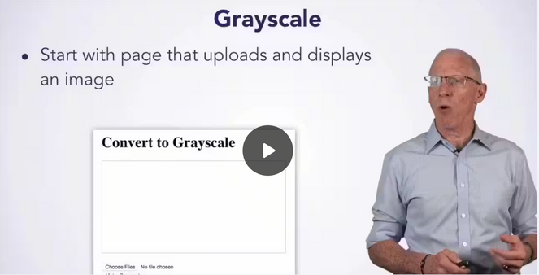
Skills Gained
After completing the certification, I gained:
  HTML page creation
  CSS styling and layout
  JavaScript fundamentals
  Event-driven programming
  Image filtering logic
  Debugging skills
  Computational thinking
Total Study Hours
Total hours completed: 32 hours
Breakdown:
  Module 1: 7 hours
  Module 2: 8 hours
  Module 3: 7 hours
  Module 4: 10 hours
1
2
This certification helped me:
  strengthen web development foundation
  build real working projects
  gain confidence in coding
  understand the logic behind programs
  start preparing for more advanced web courses
How This Certification Helps My Career
This program supports my development as:
  a future frontend developer
  a UI/UX-focused developer
  a beginner JS programmer
  a student building portfolio projects
3

Slide 14
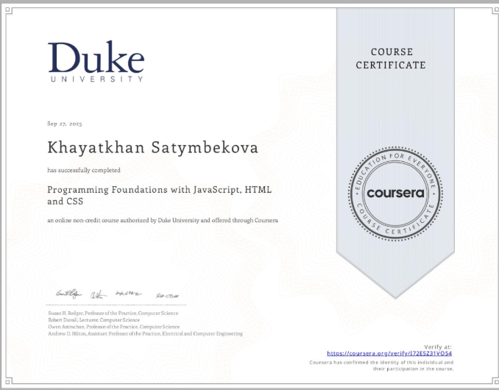
CONCLUSION
This certification was truly valuable for me because it:
  taught me how to build complete webpages from scratch;
  improved my logical thinking in JavaScript;
  strengthened my understanding of computational thinking;
  enhanced my skills for future IT and programming courses.
I highly recommend this course to all beginners who want to build a strong foundation in web development.

Slide 15
WEB DEVELOPMENT (SOLOLEARN)
My certificate:
  https://www.sololearn.com/certificates/CC-TXQBIBO6

Slide 16
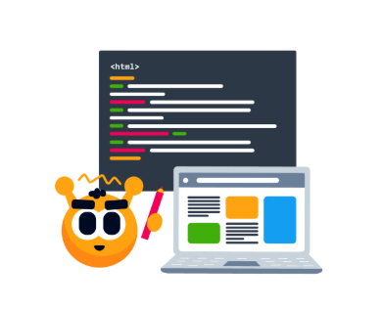
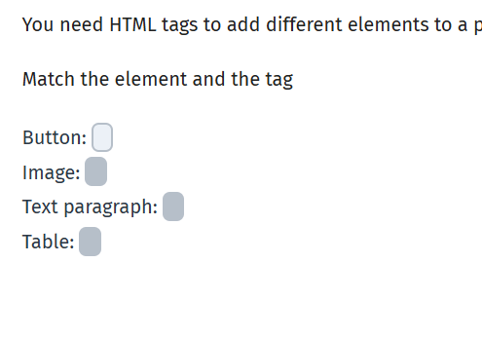
ABOUT MY
COURSE 2
In this presentation I will share the details of the Web Development course I completed on SoloLearn. This course teaches all fundamental technologies needed to build modern web pages and web applications: HTML, CSS, JavaScript and more.
Why I Selected This Course
I chose this course because:
  It provides a comprehensive introduction to web development technologies.
  It covers both markup, styling and programming → broad foundational skills.
  It is beginner-friendly — no prior experience required.
  It allows flexible self-paced learning.
  It includes modern web development practices (responsive design, DOM, events, forms, AJAX, etc.).

Slide 17
TOTAL STUDY HOURS
Throughout the SoloLearn Web Development course, I invested approximately 35–40 hours of focused study time. This includes lessons, quizzes, coding challenges, hands-on practice, and the final project.
✔ HTML — ~12 hours
• Learning structure of webpages
• Practicing tags, attributes, lists, images
• Completing HTML quizzes and small tasks
• Building simple webpage layouts
✔ CSS — ~10 hours
• Studying selectors, colors, fonts, margins, padding
• Applying styles to previous HTML pages
• Completing styling challenges
• Experimenting with layouts and design
✔ JavaScript — ~13 hours
• Studying variables, functions, DOM, events
• Building interactive mini-programs
• Working with buttons, sliders, and user input
• Debugging and testing code
Additional Practice & Final Project — ~5 hours
• Designing and coding the image-filter web application
• Testing different filters and improving UI
• Revising earlier modules to integrate HTML+CSS+JS
• Fixing errors and finalizing project files
Total learning time:
35–40 hours of active, hands-on learning

Slide 18
SKILLS GAINED
COURSE OVERVIEW
During the course I learned how to:
  Create structured web pages with HTML
  Style pages with CSS for layout, colors, and responsive design
  Use JavaScript to add interactivity and dynamic content
  Manipulate the DOM to update page content dynamically
  Handle user events (clicks, inputs, form submission)
  Build and validate web forms
  Fetch data from APIs with AJAX and integrate external data
  Optimize pages for better performance and responsiveness
The Web Development course on SoloLearn covers: HTML basics, CSS styling, JavaScript, responsive design, DOM manipulation, events & event handling, forms and validation, AJAX & API usage, and performance optimization.

Slide 19
WHAT YOU LEARN (COURSE CONTENTS)
The course includes:
  HTML fundamentals: page structure, tags, attributes, multimedia, forms, tables, lists.
  CSS styling: selectors, layout, box model, backgrounds, tables & forms styling, responsiveness.
  JavaScript basics: variables, data types, functions, loops, conditionals, DOM & event handling.
  Advanced web functionality: responsive design, AJAX & API usage, performance optimization.
BENEFITS FOR ME
This course gave me a strong foundation in front-end web development — exactly what is needed to build real websites. It improved my understanding of how web pages are built, how styling and logic work together, and how to create responsive, interactive, and data-driven web applications.

Slide 20
COURSE CONTENT — WEB DEVELOPMENT (SOLOLEARN)
Web Development (Main Module)
This module gives a full introduction to building modern websites using HTML, CSS, and JavaScript.
HTML Section
Getting Started with HTML
  What HTML is and how it works
  Basic structure: <html>, <head>, <body>
  Creating your first webpage
  Text elements: headings, paragraphs, line breaks
Going Deeper with HTML
  Lists: ordered and unordered
  Links: internal & external
  Images: src, alt, width, height
  Tables: rows, columns, borders
Using Attributes
  Global attributes (id, class, style)
  Adding metadata
  Formatting tags: <b>, <i>, <u>
  Links with target, title
Mastering HTML
  Semantic tags: <header>, <footer>, <section>, <article>
  Forms: text input, password, email, textarea
  Buttons & form submission
  HTML validation
CSS Section
Getting Started with CSS
  What CSS is and how it styles HTML
  Inline, internal, and external CSS
  Colors, backgrounds, borders
  CSS selectors: element, class, id
Styling Elements
  Text styling: fonts, size, weight, decoration
  Box model: margin, padding, border
  Display: block, inline, inline-block
  Styling containers
Page Design and Layout
  Positioning: relative, absolute, fixed
  Flexbox basics
  Page layout with responsive design
  Styling navigation bars
Transitions & Transforms
  CSS animations
  Hover effects
  Scaling, rotating, translating elements
  Smooth visual effects
JavaScript Section
Welcome to JavaScript
  Basic syntax
  Variables (let, const)
  Comments
  Output methods
Going Deeper with JavaScript
  Functions
  Parameters and return values
  String and number operations
Working with Data
  Arrays
  Objects
  JSON basics
  Modifying and accessing data
Control Flow
  If, else, else-if
  Switch statements
  For loops, while loops
  Logical operators

Slide 21
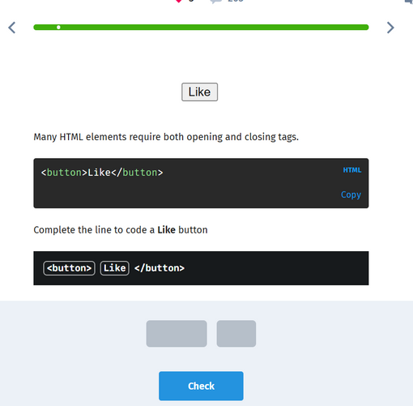
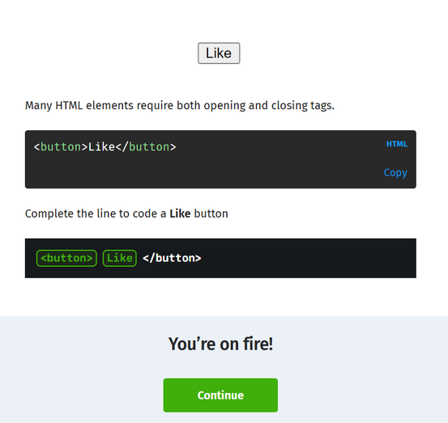
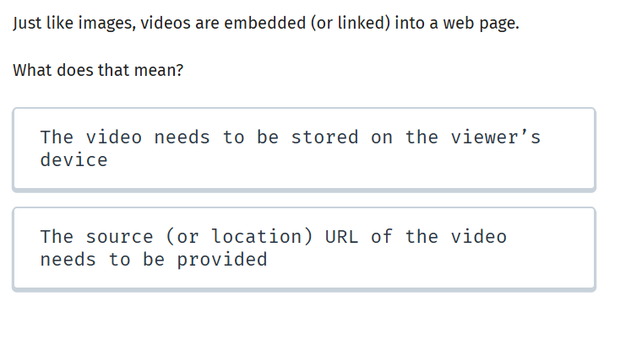
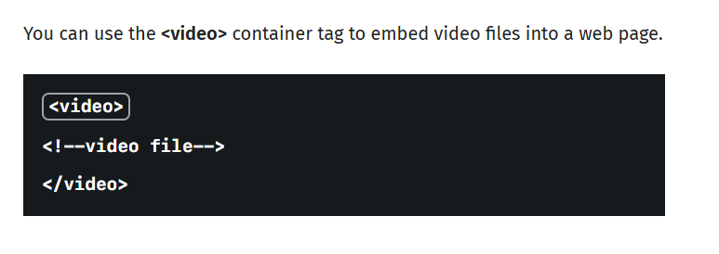
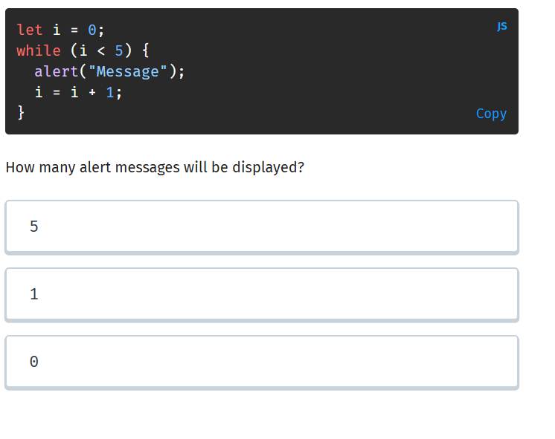
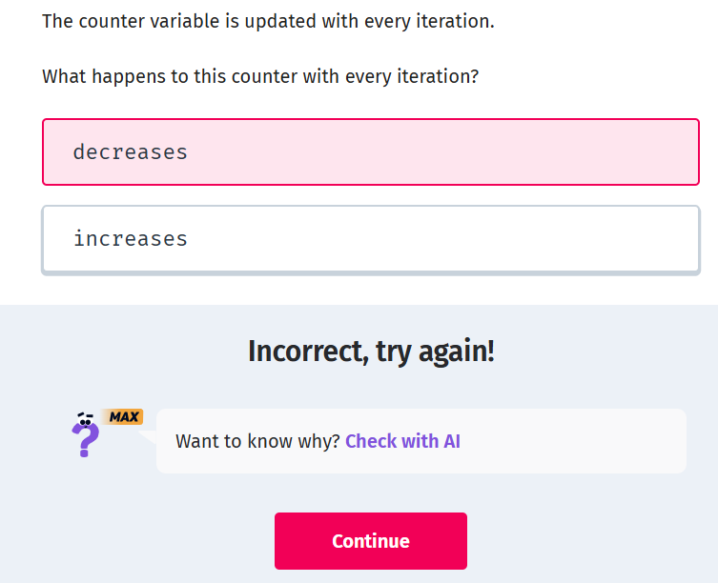

Slide 22
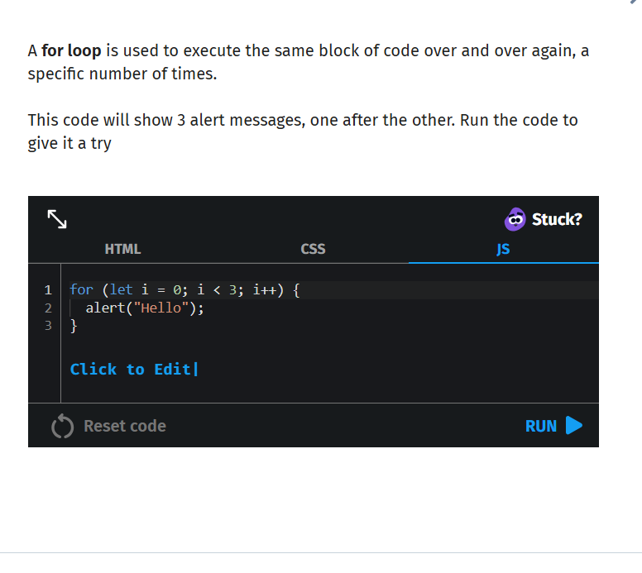
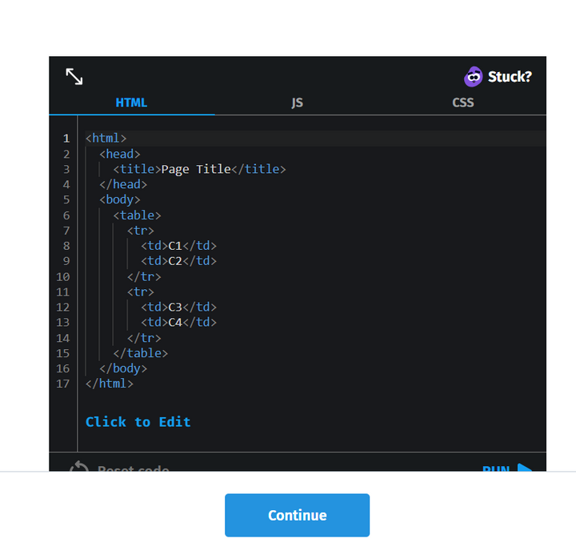
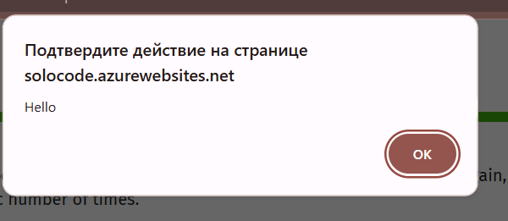
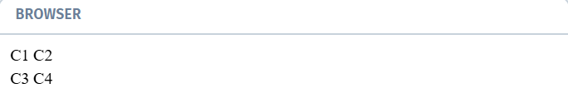

Slide 23
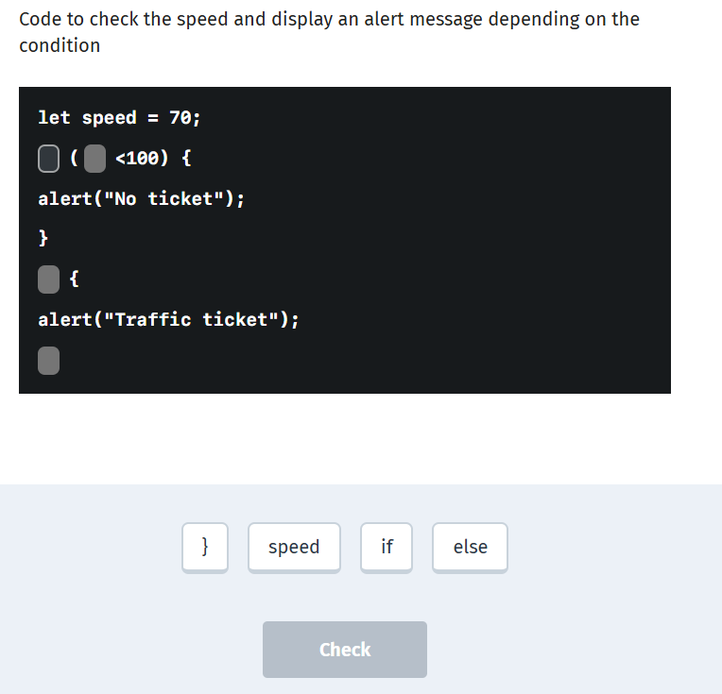
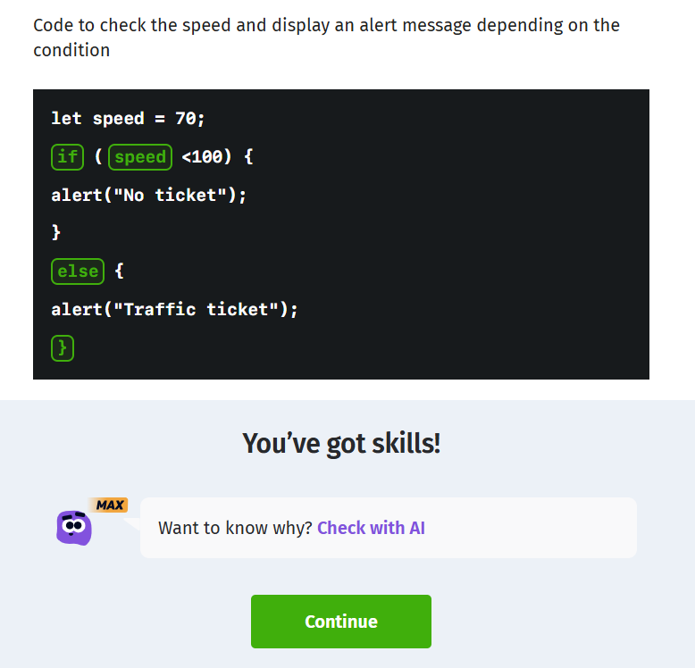

Slide 24
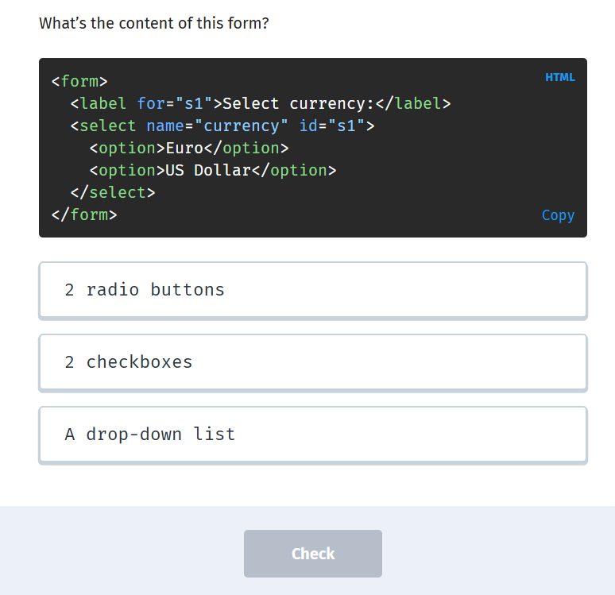
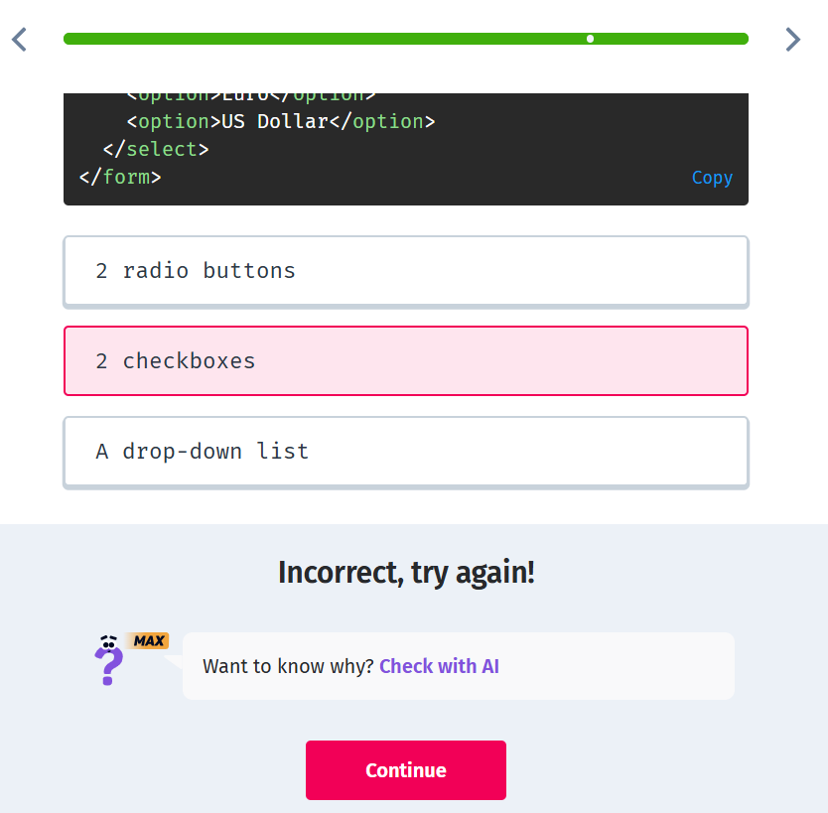

Slide 25
RECOMMENDATION
How This Fits My Goals
I recommend this Web Development course on SoloLearn to anyone who is starting their journey in web programming. It’s beginner-friendly, flexible, covers essential technologies, and builds a strong foundation.
I plan to continue learning more advanced web technologies and build personal projects. The foundation from this course gives me a base to move further: build interactive apps, work with APIs, and eventually learn frameworks and full-stack development.

Slide 26
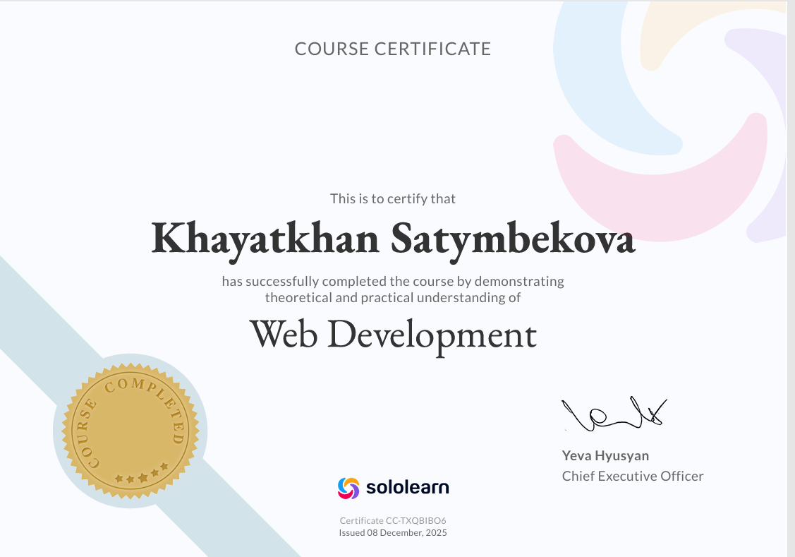

Slide 27
CONCLUSION
Completing the Web Development certification has been a highly valuable experience that strengthened both my technical skills and my confidence in building real-world web applications. Over the past month, I dedicated more than 35 hours to learning and practicing HTML, CSS, and JavaScript, which allowed me to understand not only how websites are structured, but also how they behave and interact with users.
This certification helped me develop a strong foundation in front-end development, improve my problem-solving skills, and gain practical experience through hands-on exercises and project work. I now feel more prepared to continue my learning journey in web technologies and move toward more advanced tools, frameworks, or full-stack development.
Overall, this program proved to be a meaningful step in my professional growth, and it has motivated me to pursue further certifications to expand my expertise and stay competitive in the tech field.

Slide 28
Coursera — Programming Foundations with JavaScript, HTML and CSS
SoloLearn — Web Development
Coursera — Programming Foundations with JavaScript, HTML and CSS
I completed this course on Coursera, offered by Duke University. During the course, I learned the fundamentals of web development: HTML, CSS, JavaScript, working with user interfaces, and basic programming principles. This certificate confirms that I successfully completed structured learning on a reputable educational platform, where the material is delivered systematically and accompanied by practical assignments.
I earned this certificate by completing a course on the SoloLearn platform. The learning here was more basic and self-directed. The course helped me reinforce my skills in HTML, CSS, and JavaScript, and motivated me to practice and develop my own projects.

Slide 29
COMPARISON:
  Both courses confirm my knowledge in web development, but Coursera provides more structured and academically recognized training.
  The SoloLearn certificate demonstrates my independence and commitment to continuous learning.
  While the Coursera certificate can serve as serious proof of competency for work or studies, the SoloLearn certificate highlights initiative and practical motivation.
Together, both certificates show my dedication to growing in web development: first thoroughly learning the material through Coursera, and then reinforcing my skills with SoloLearn.

Slide 30

OVERALL CONCLUSION:
Both certificates demonstrate my dedication to learning and improving my skills in web development. The Coursera certificate reflects structured, academically recognized training, providing a solid foundation in HTML, CSS, and JavaScript. The SoloLearn certificate highlights my initiative, self-motivation, and commitment to continuous practice and project development. Together, they showcase a balanced combination of formal learning and hands-on experience, proving that I am capable of applying my knowledge in real-world web development tasks and continuously advancing my skills.

Slide 31

THANK YOU
  https://coursera.org/share/9fe8efd392131b022b2282ac160aa898
  https://www.sololearn.com/certificates/CC-TXQBIBO6
hayathansatymbekova@gmail.com

